Slide 1
Supergrid Modelling for the Indian Subcontinent
Farhan Beg
Global Energy Network Institute
With Inputs from Mr. Peter Meissen and Mr. Paul Michael Dekker

Slide 2
Supergrid
High Voltage Energy Corridor that is based on an HVDC transmission network
Carries large quantities of power across long distances and between countries
Capability of integrating renewable energy into the grids

Slide 3
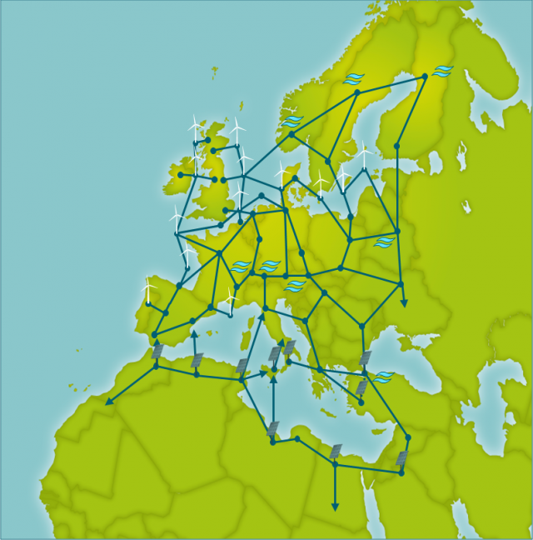
The European Supergrid
European Supergrid with proposed renewable integration from Northern Africa consisting of a meshed grid structure
Source: www.earthtimes.org

Slide 4
Scope of the Supergrid Deployment
Large Renewable Energy Potential is located in the Indian Subcontinent
Not in Immediate Proximity to Load centers
Strong need to integrate the renewable energy into existing electricity grid
Curb the energy shortages
Improve quality of electricity
Regulate the price of electricity

Slide 5
Energy Transfer from Generation to Demand Locations
Cluster of load centers
Cluster of generation centers
[Farhan Beg 2014]
Positive Energy Gradient from east to west
Positive Load Gradient from west to east

Slide 6
What will it look like?
[Farhan Beg 2014]
The proposed draft model of the Supergrid for the Indian subcontinent

Slide 7
Need based Assessment of the Member Countries
Scale and complexity of the project
Huge variation of economic and cultural trends across the subcontinent
Individual member countries’ needs have to be respected

Slide 8
Energy Assessment of India
Shortage of coal at Coal based generating plants
Refining and extraction of Coal does not match the coal utilization factor of the plants
Import of Gas not a feasible option.
Renewable energy resources far from the load centers.
Figure: Electricity Generation from different sources (2011) [Farhan Beg 2014]

Slide 9
Energy Assessment of Pakistan
Electricity supply is highly unreliable.
Load shedding and power outages are a common scene every day.
Energy shortages at generating stations
Figure: Electricity Generation from different sources (2011) [Farhan Beg 2014]

Slide 10
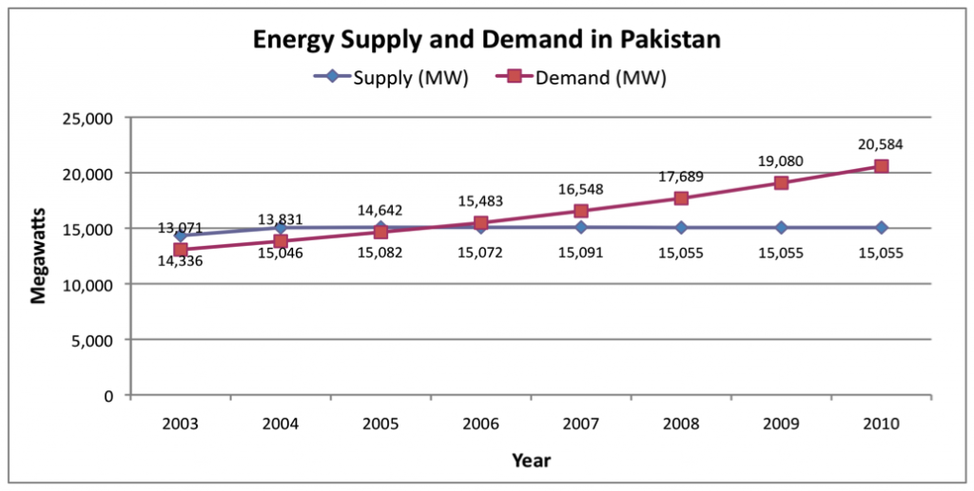
Pakistan’s Supply/Demand Inconsistency
Source: EIA Annual Report, Energy trends
Pakistan’s supply side has seen no growth over the years with the demand increasing consistently

Slide 11
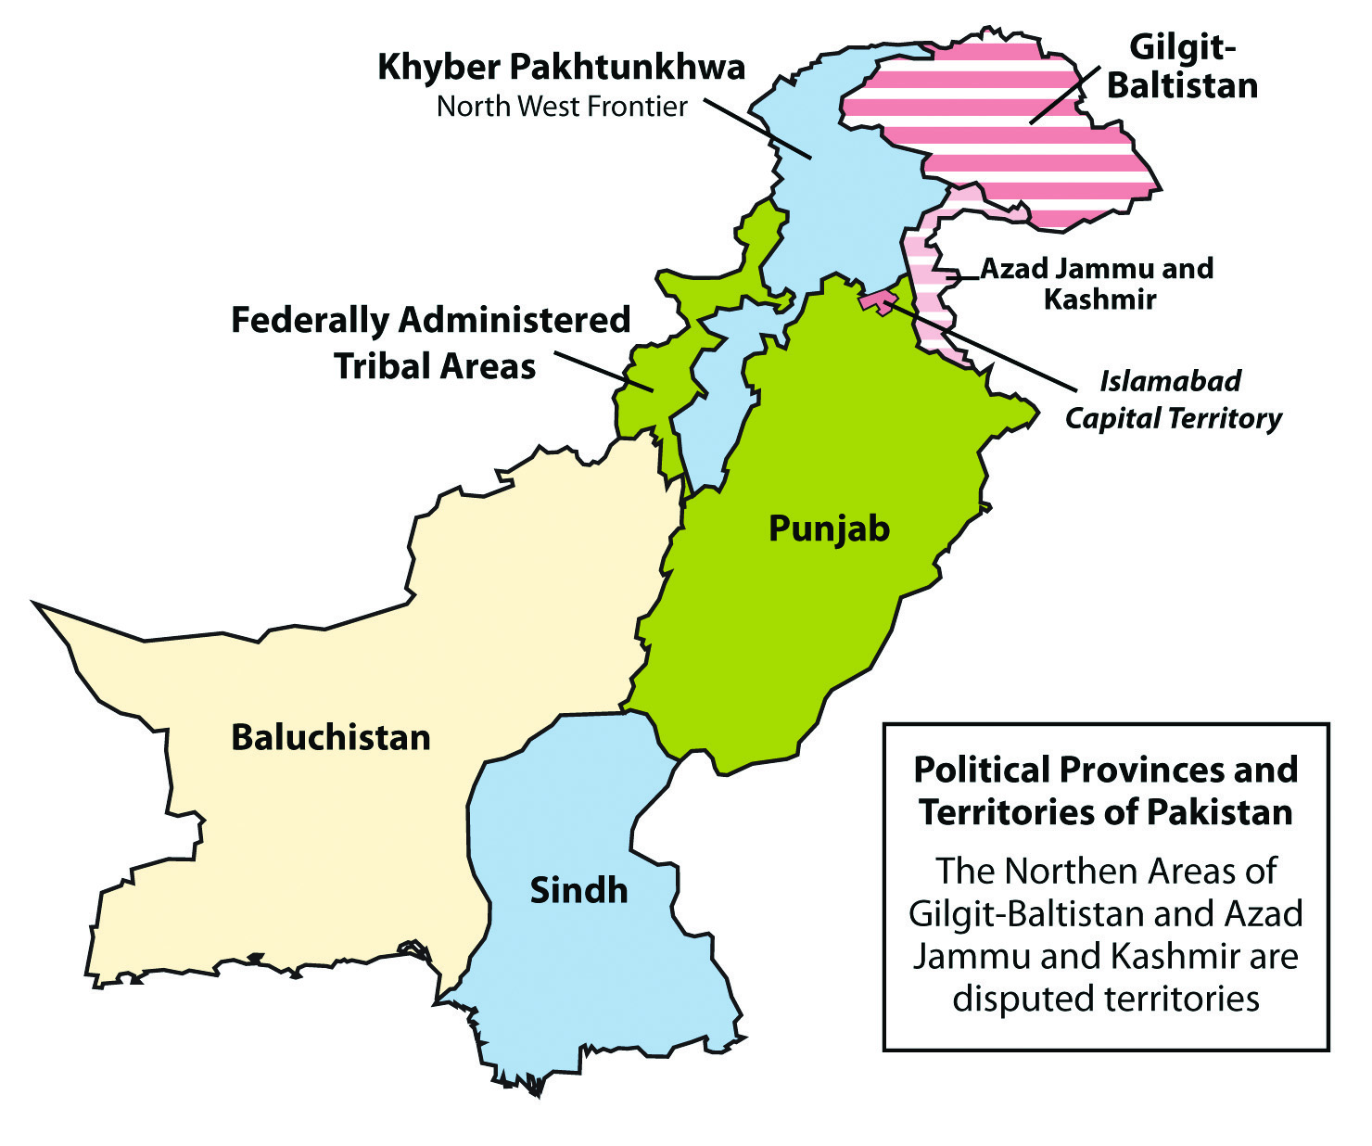
Location of Sindh Valley
[Farhan Beg 2014]
Total Wind Potential of Pakistan is 150 GW
Wind Potential of the Sindh Valley is 50 GW
Sindh valley has been identified as a potential Wind Energy source for integration into the supergrid for the power flow analysis

Slide 12
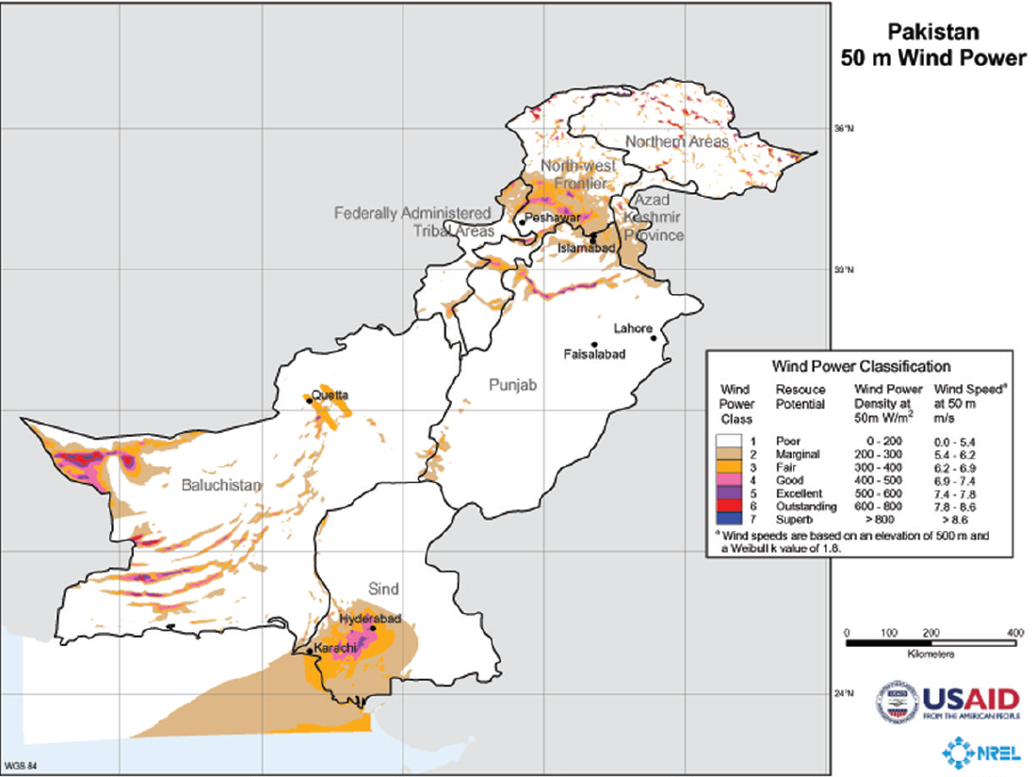
Pakistan Wind Resources

Slide 13
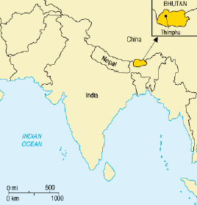
Energy Assessment of Bhutan
As of 2012, only about 70% of households had access to electricity
Hydro power potential of around 30GW
Exports more than 75% of hydroelectricity to India
Developmental goals based on foreign exchange from the export of hydro power.
Source: www.nrel.gov
Figure: Bhutan Total Electricity Exports Source: www.tudorancea.com

Slide 14
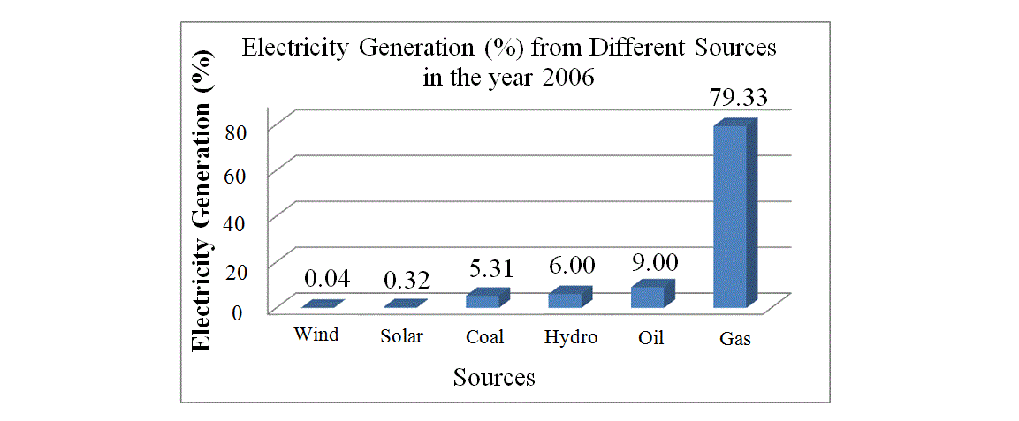
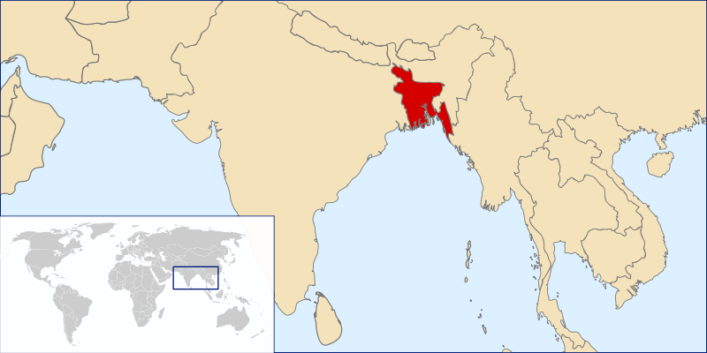
Energy Assessment of Bangladesh
Figure: Bangladesh location
Source: wikipedia.org/bangladeshelectricity
Source: Wikipedia.org/bangladesh

Slide 15
Electricity Generation Capacity of Bangladesh
Growth Rate of 6.6%
Electricity capacity will be nearly 10,000 MW by 2020, which is far from the estimated demand of 15000 MW.
[Farhan Beg 2014]

Slide 16
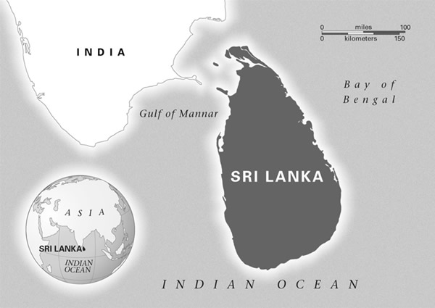
Energy Assessment of Sri Lanka
Sri Lanka has total identified hydro power potential of 2GW out of which nearly 1.5GW has already been harnessed
Energy demand will outpace energy generated in Sri Lanka in the next 20 years.
Source: www.wikipedia.org/srilanka

Slide 17
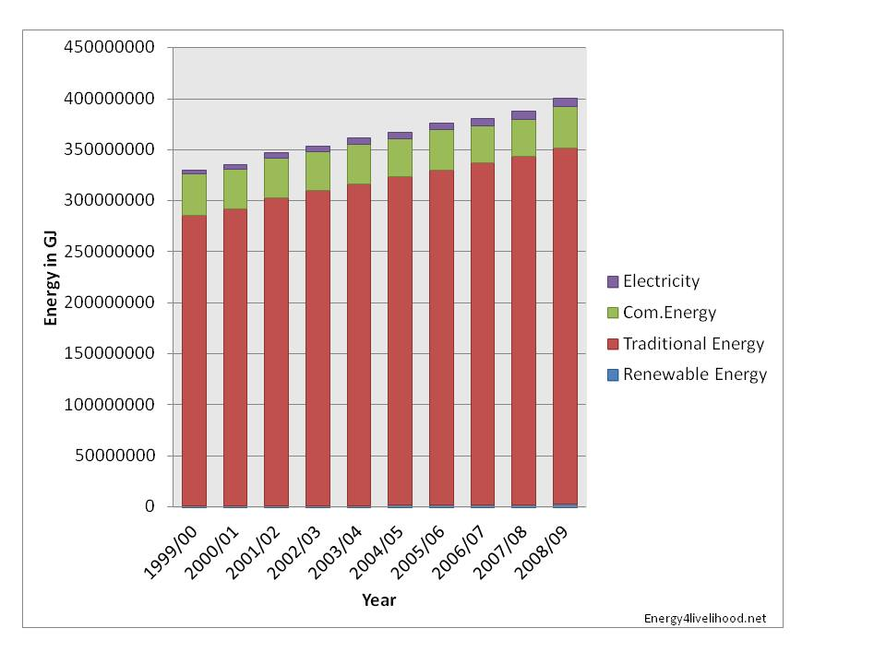
Energy Assessment of Nepal
Overall fuel wood supplies nearly 80% of energy consumption.
Total potential of electricity generation about 83GW
Potential tapped 0.28GW
40% of households have access to electricity
Source: energy4livelihood.com

Slide 18
Country-wise Potential/Tapped
218
755
[Farhan Beg 2014]

Slide 19
Supergrid Modelling
Provide an electricity highway for the flow of electric power between nations
Provide a capability to interconnect the asynchronous transmission systems of the subcontinent
Efficiently control the exchange of seasonally varying production and storage capacities.

Slide 20
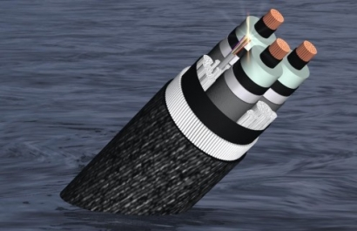
State of Technology
Three-Phase AC technology 50 Hz (AC grids) with voltages >400 kV (750 kV, 1000 kV)
Three-Phase AC technology with reduced frequency (AC grids 16 2/3 Hz) with voltages >400 kV
High Voltage Direct Current Transmission
Power transfer equation
P=$V1$*$V2$*$Sin$($δ$)
2*$π$*$frequency$

Slide 21
Increase in Transmission Voltage Levels
Source: PowerGrid Corporation of India Limited
Synchronous System Connections
Asynchronous System Connections

Slide 22
Multi Terminal DC Connections
Two choices of connections
Series
Parallel
Generator
Transmission Line
Converter Station
[Farhan Beg 2014]
Figure: Parallel multi terminal DC connections for the Supergrid.

Slide 23
Power Flow Analysis
A tool to obtain the best working conditions for an interconnected system.
Conditions are obtained by solving the voltage and current balance equations at the nodes.
For DC network the power flow is simpler.
[Farhan Beg 2014]

Slide 24
Draft Model of the Supergrid
{Farhan Beg 2014}

Slide 25
Supergrid Modelling
AC/DC Buses
[Farhan Beg 2014]

Slide 26
For any inquiries, please contact the author at farhan.beg@geni.org
Farhan Beg is a power engineer from the National Institute of Technology, Srinagar, India and is a researcher at the Global Energy Network Institute, San Diego, CA, USA
This is an ongoing research project at the Global Energy Network Institute, San Diego, CA, USA
For a detailed analysis of the supergrid modelling and the technical concepts please visit the report “Supergrid Modelling and Risk Assessment for the Indian Subcontinent” at www.geni.org

