Slide 1
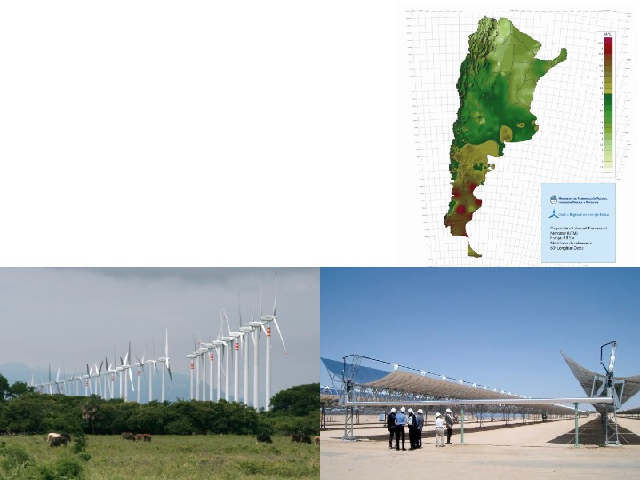
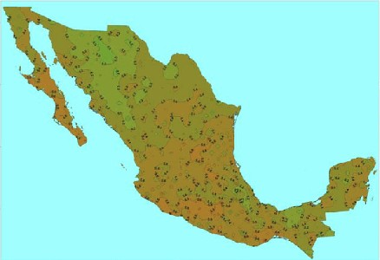
AGRION Wind and Solar in Latin America Discussion

Slide 2
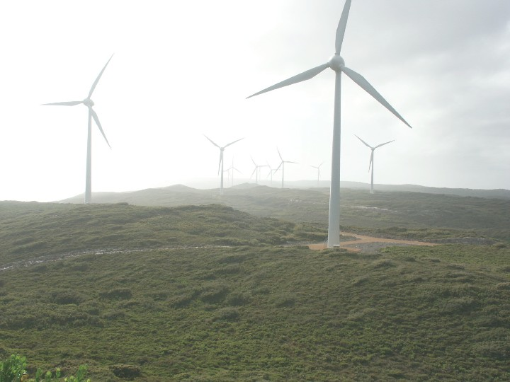
Outline
Recent Trends and Resource Potential for wind and solar in Latin America
Policy drivers and policy landscape
Challenges going forward

Slide 3
Recent Trends: lots of momentum for wind power
Source: BP Statistical Review of World Energy June 2011

Slide 4
Recent Trends: lots of momentum for wind power
Source: BP Statistical Review of World Energy June 2011

Slide 5
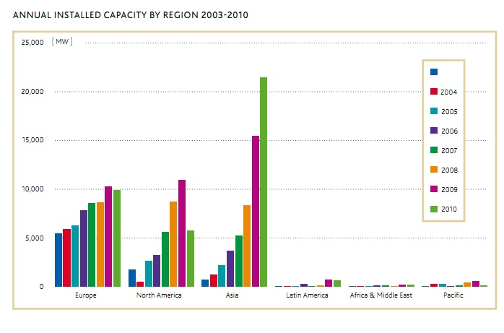
Recent Trends: room for more development of wind capacity
Source: GWEC 2010 Global Wind 2010 Report

Slide 6
Recent Trends: weak momentum for solar
Source: BP Statistical Review of World Energy June 2011, EPIA Report September 2010

Slide 7
Recent Trends: weak momentum for solar
Source: BP Statistical Review of World Energy June 2011, EPIA Report September 2010

Slide 8
Recent Trends: weak momentum for solar
Source: BP Statistical Review of World Energy June 2011, EPIA Report September 2010

Slide 9
Recent Trends: weak momentum for solar
Source: BP Statistical Review of World Energy June 2011, EPIA Report September 2010

Slide 10
Recent Trends: weak momentum for solar
Source: BP Statistical Review of World Energy June 2011, EPIA Report September 2010

Slide 11
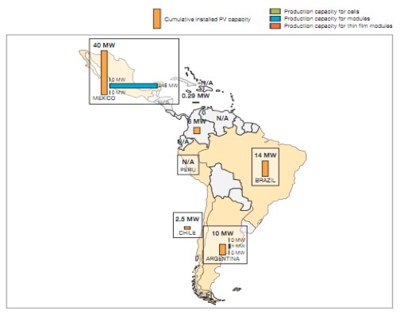
Recent Trends: weak momentum for solar (but Mexico leads)
Source: EPIA Report September 2010

Slide 12
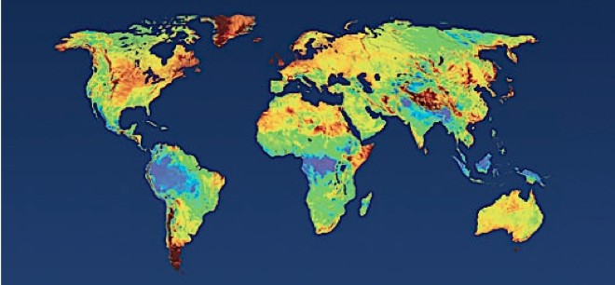
Resource Potential: Excellent wind potential
Source: 3Tier , Free copy available here

Slide 13
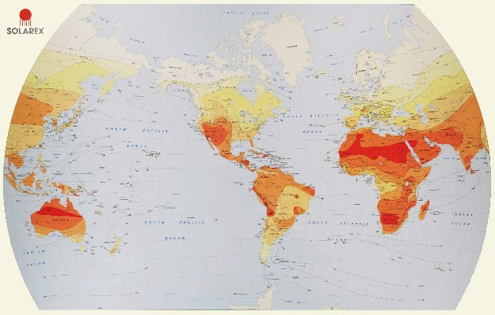
Resource Potential: Excellent solar potential
Spain, Germany and Italy
Latin America
Source: http://solarcooking.wikia.com

Slide 14
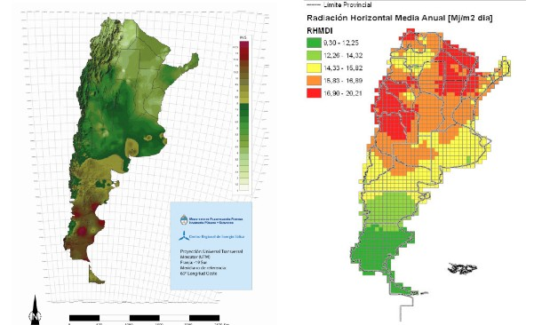
Resource Potential: Argentina Wind/Solar Potential
Wind:
Solar:
Source: Meisen and Krumpel, Renewable Energy Potential of Latin America 2009

Slide 15
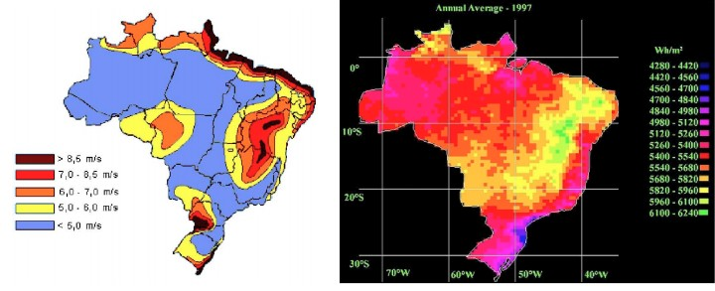
Resource Potential: Brazil Wind/Solar Potential
Wind Intensity:
Solar Intensity:
Source: Meisen and Krumpel, Renewable Energy Potential of Latin America 2009

Slide 16
Resource Potential: Brazil Wind/Solar Potential
Wind and solar: Piaui, Bahia, Minas Gerais
Wind Intensity:
Solar Intensity:
Source: Meisen and Krumpel, Renewable Energy Potential of Latin America 2009

Slide 17
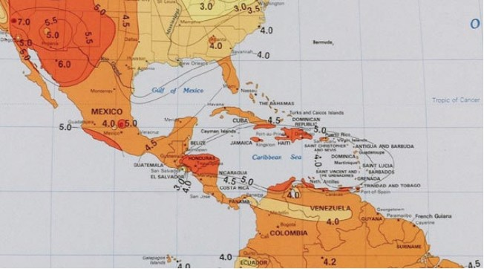
Resource Potential: Mexico Solar Potential
Sonoran Desert
Source: Meisen and Krumpel, Renewable Energy Potential of Latin America 2009

Slide 18
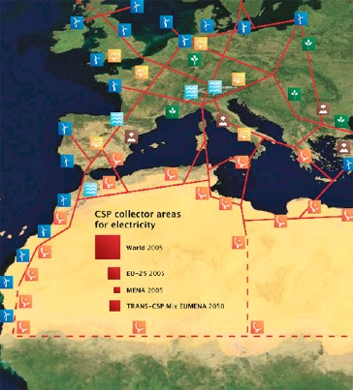
Some context: Desertec Initiative
Immense solar potential that exists in a desert
Deserts and ecological questions
The need for scaled CSP
www.desertec.org/

Slide 19
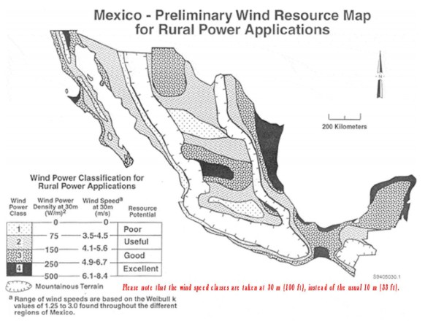
Resource Potential: Mexico Wind Potential
Source: Meisen and Krumpel, Renewable Energy Potential of Latin America 2009

Slide 20
Policy drivers
Energy security
Declining costs of renewable energy, especially solar

Slide 21
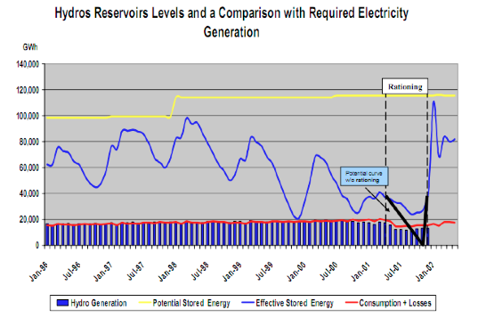
Policy Drivers: Energy security and the downsides of hydropower
• Brazilian drought in summer 2001, lack of hydro-reserves
Source: Center for Energy Economics Brazil’s Power Market Crisis 2002

Slide 22
Policy Drivers: Energy security and volatility of natural gas prices
Source: BP Statistical Review of World Energy June 2011

Slide 23
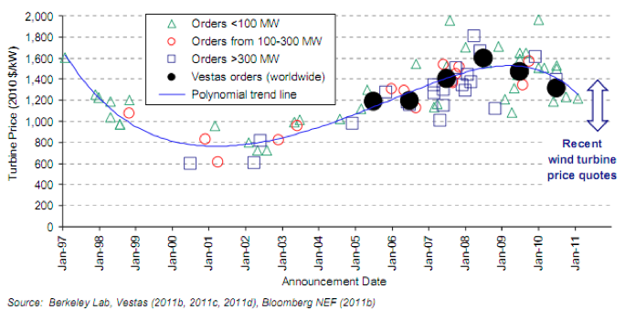
Policy Drivers: Recent declining costs of wind power
Link: http://eetd.lbl.gov/ea/ems/reports/lbnl-5119e.pdf

Slide 24
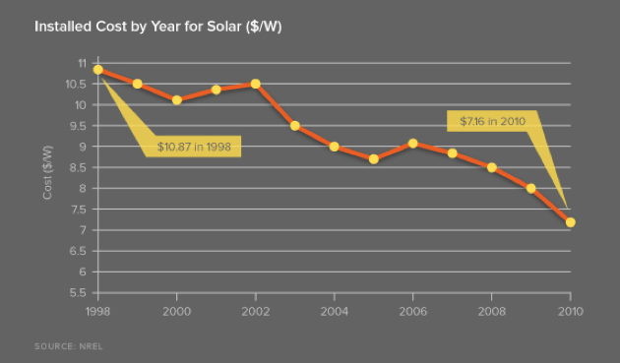
Policy Drivers: Declining costs of PV solar power
Source: OpenPV NREL Database

Slide 25
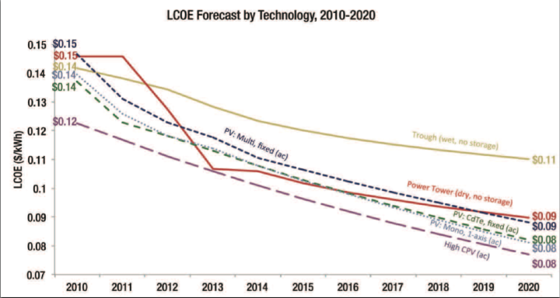
Policy Drivers: Declining costs of solar overall
Source: Greentech Media Research:
Concentrating Solar Power 2011: Technology, Costs and Markets

Slide 26
Policy Landscape: Renewables policies
Regulatory policies
  Feed-in tariff
  Renewable Portfolio Standard (RPS) (Utility quota obligation)
  Tradable renewable energy certificate (RECs)
Fiscal incentives
  Tax incentives
  Conditional grants
Public financing
  Public loans, public competitive bidding

Slide 27
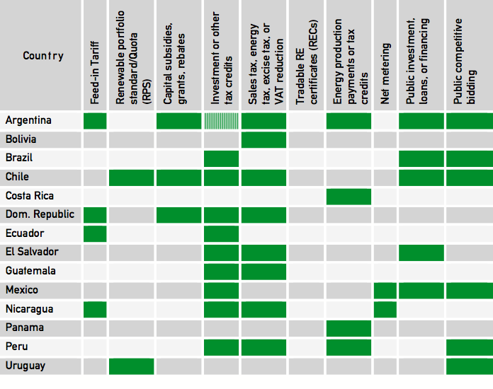
Source: REN21 2010 Global Status Report

Slide 28
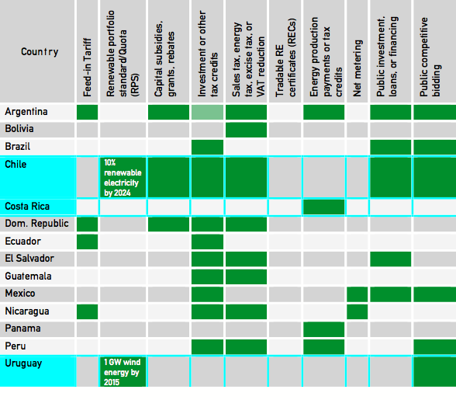
Source: REN21 2010 Global Status Report
Highlighted countries received highest scores on World Bank governance and rule of law indices.

Slide 29
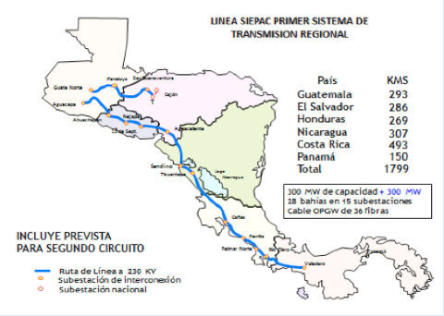
Policy Landscape: Regional Partnerships
Sistema de Interconexión Eléctrica de los Países de América Central (SIEPAC)

Slide 30
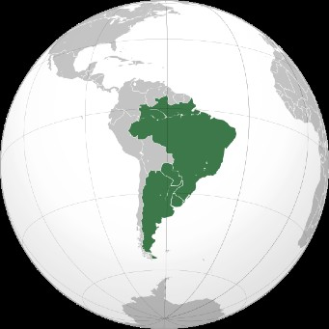
Policy Landscape: Regional Partnerships
MERCOSUR: Uruguayan initiatives to integrate the production of renewable energy
Links: http://www.rechargenews.com/energy/wind/article287636.ece,
http://en.mercopress.com/2011/06/29/argentina-asks-mercosur-to-draft-an-industrial-policy-and-contain-asian-imports

Slide 31
Challenges
End of the CDM as Kyoto period expires in 2012
Centralizing all policy information related to the region into one database
Fostering more meaningful regional integration and coordination

Slide 32
Global Energy Network Institute (GENI)
http://www.geni.org/
1-619-595-0139
Peter Meisen, Founder and President
Derek Urmston, Research Associate

