Slide 1
Renewable Energy Potential of Chile
Peter Meisen Shayla Woodhouse
President, GENI Research Assistant, GENI
peter@geni.org shayla.woodhouse@gmail.com
http://www.geni.org

Slide 2
Background
Location: South America
Size: 756,102 km² (twice the size of Montana)
Climate: Desert, Mediterranean, Wet & Cold
Population: 16,800,000
CO₂ Emissions
4.3 tons of carbon per person (5th in the Americas)
62.55 million tons of carbon (50th in the world)

Slide 3
Current Energy Demand
1.215 quadrillion Btu, 2008
COAL – Colombia, Indonesia, Australia, Canada
5.8 million tons, 2008
OIL – Ecuador, Angola, Colombia
230,000 barrels/day
NATURAL GAS –Argentina
Primary energy supply, 2007

Slide 4
Electricity Grid
Grid of 4 electricity systems

Slide 5
Current Electricity Demand
13,275 MW, 2007
56.35 billion
kilowatt-hours, 2008
5.5 -6.5 % average
increase per year,
2008-2025
Installed capacity by generation, 2007

Slide 6
Renewable Energy Potential
Non-Conventional Renewable Energy
“Electrical energy generate through non-conventional, renewable primary energy sources such as biomass, wind, geothermal, solar and hydropower that has a capacity less than 20 MW.” CER Website
2.4% installed capacity derived from NCRE’s (2008)
NCRE Potentials
Small hydropower
Solar
Wind
Geothermal
Ocean
Biomass

Slide 7
Hydropower
Controversy
HidroAysén proposed to build 5 dams in Patagonia region
Disapproved by public- caused demonstrations
Water shortages
Droughts to increase over next 40 years
Non-Conventional
Small hydropower, run-of-the-river
Potential <20 MW = 10,000 MW

Slide 8
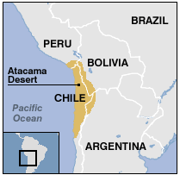
Solar
Atacama Desert: Very dry & arid
0.6 mm annual rainfall
600 miles long
Irradiance: 275 W/m² = 275 MW/ km²
Mining consumes: 4,911 MW
18 km² OR 3,600 football fields
of solar would satisfy this demand
Atacama Desert (in yellow)

Slide 9
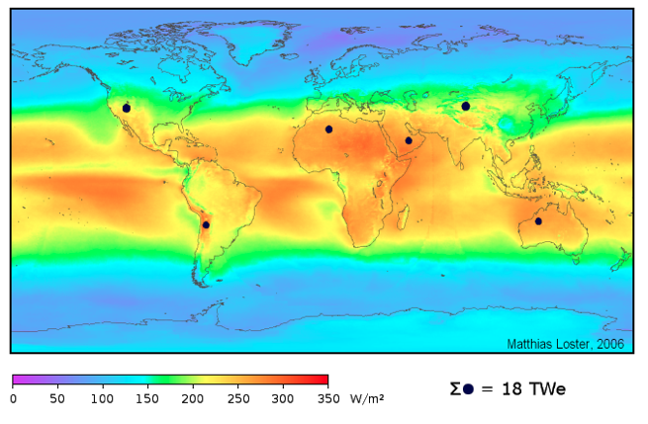
Solar Cont.
Each dot represents surface needed to produce 3 TW
Map of the world’s solar energy

Slide 10
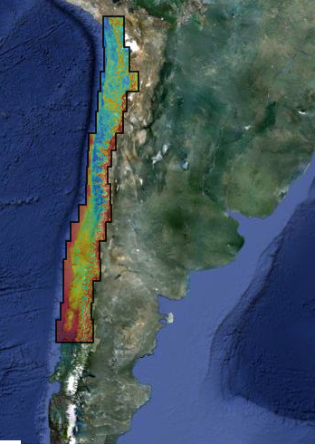
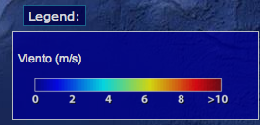
Wind
Wide selection of locations to
harvest wind energy
Totoral wind farm = 46 MW
50,000 homes
Removal of 15,000 cars off the road
Potential = 40,000 MW
43,478,000 homes
Removal of 13,043,400 cars off the road
Wind energy potential

Slide 11
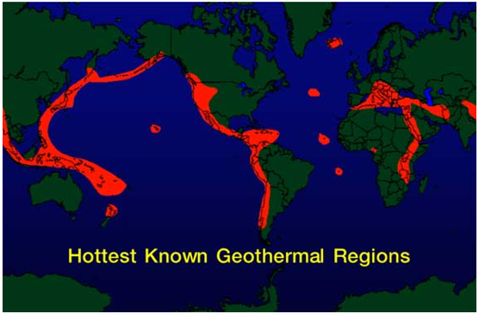
Geothermal
Contains 10% of world’s most active volcanoes
At least 120 locations of potential
Potential = 16,000 MW (over a 50 year period)

Slide 12
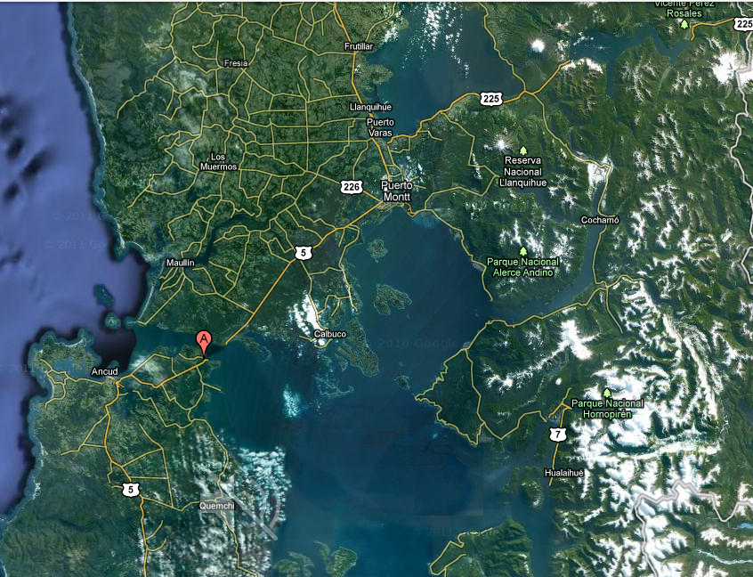
Ocean/Marine
Chacao Channel = 3rd most energy currents in the world
Approx. 2,000 MW
Potential = 164,000 MW
“Chile is the country with the highest wave energy potential in the world,” reported a British engineering consultant at Baird & Associates
Chacao Channel, Ancud (shown as Red
Mark) , 5th region

Slide 13
Biomass
Energy derived from plant & animal sources
Potential in Chile from…
Sewage & landfills
Waste from forest management & harvesting
Logging industries
Potential = 1,370 MW

Slide 14
A Growing Country
2011
2020
16,888,760 million people
0.836% annually
13,275 MW
6% annually
18,208,496 million people
22,779 MW

Slide 15
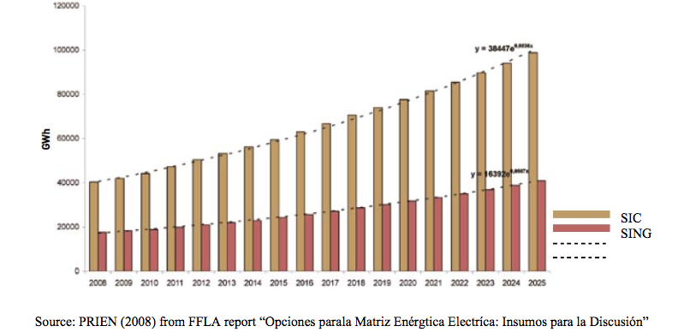
Electricity Projection
Projected electricity generation in Chile, 2008-2025

Slide 16
Conclusions
Variety of renewable energy sources given it’s unique geography
Amend law 20.257 to increase NCRE’s at a quicker rate
Benefits of renewable energy
Jobs
Economy
Stable
Sustainable
Healthier
Republic of Chile flag

Slide 17
Works Cited
http://www.cne.cl
http://www.eia.gov/countries/country-data.cfm?fips=CI
http://www.cne.cl/cnewww/export/sites/default/08_Normativas/02_energias/descargable_renovables/regla_geotermia_xDoc_7x.pdf
http://www.investchile.cl/opportunities/renewable_energy/renewable_energy
http://www.ez2c.de/ml/solar_land_area/
http://www.oceanenergycouncil.com/index.php/Wave- Energy-News/Chile-is-the-country-with-the-highest-wave-energy-potential-in-the- world.html
http://condor.dgf.uchile.cl/EnergiaRenovable/Chile/
http://www.geni.org
Chile Energy Policy Review 2009. Paris: Organisation for Economic Co-operation and Development / International Energy Agency, 2009.
Google maps

